Slide 1


Slide 2

#LifeKoKaroLift
SGC Coaching:
Articulate your Journey | Activate Your Vigour| Accelerate Mutual Growth
Session 20
RNN

Slide 3
Agenda
Quick Recap – (15 min)
Focused Teaching (60 min)
Doubts Resolutions (15 min)
Word Embedding
doubts resolutions
Last 2 weeks

Slide 4
Recap: What the learner have learnt in the week
Quick Glance at Key Learnings
Word Embedding
Embedding Methods
Basics
When to use
What is
When to use
Word2Vec
Glove
Custom Embedding

Slide 5
Problem
Why NLP is different than others?
Start Understanding a Text.
Ram kill Shyam
Shyam kill Ram
Both are same?
Sequence Matter.

Slide 6
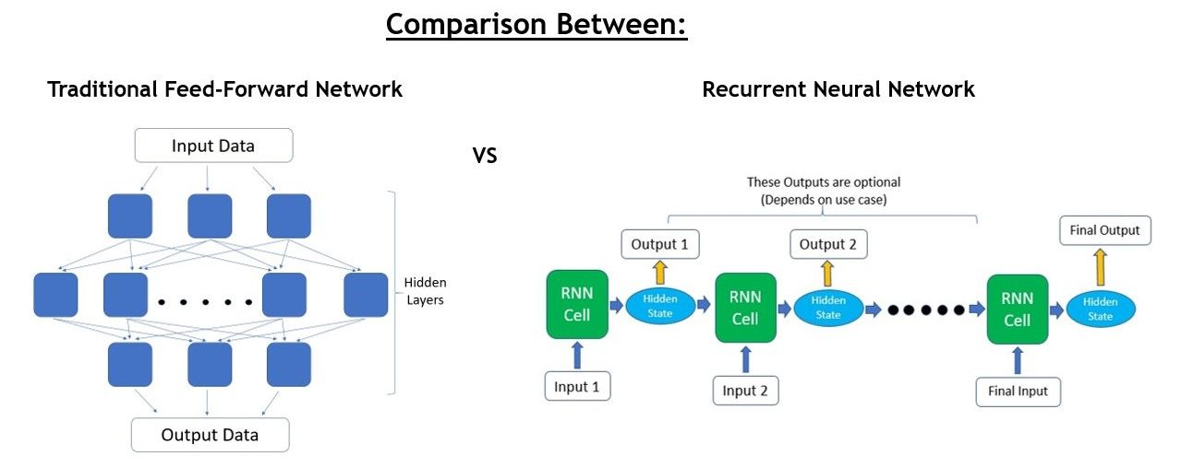
Problem

Slide 7
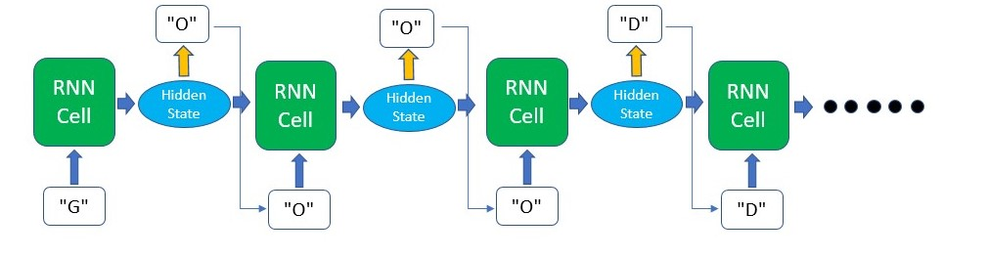
RNN Arch

Slide 8
Coding Time
Coding Time

Slide 9

Doubts Resolutions

